Slide 1
Standard Analytics on Dataset
-Presented by
Adrija Chakraborty
B Sindhu
Likhitha Gaddi

Slide 2
Aim of Project:
This project aims at performing various types of standard analytics on a set of available datasets. It aims to perform the following things:
Display a list of available datasets
Perform standard analytics like mean, median, mode on the attributes of a selected dataset.
Track Number of downloads for each dataset
Monthly analyse the number of downloads and report the analysis

Slide 3
Tech Stack Used:
REST FRAMEWORK:
Front end: REACT
Back end: DJANGO

Slide 4
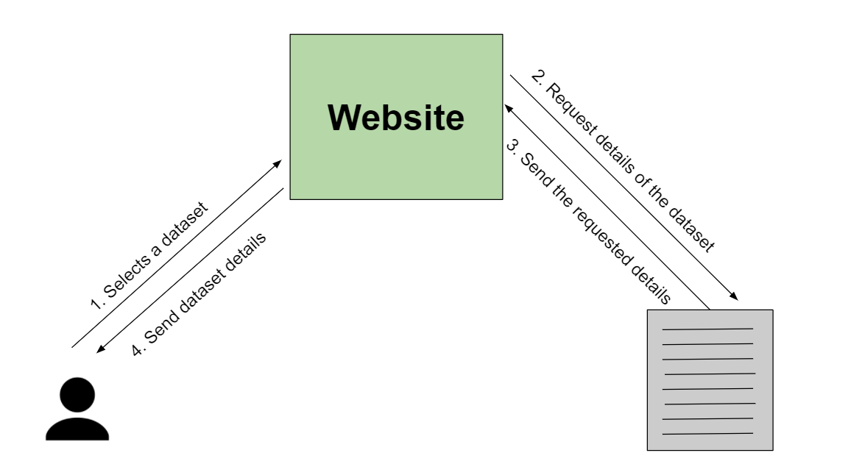
Process Flow

Slide 5
Workflow:
Planning SRS and Design Document:
Understanding requirements
Which tech stack will be best suited for our work?
What development model should be used?
Learning basic functionalities on the selected tech stacks
Watching videos
Reading blogs on the tech stacks
Creating mini projects
Creating skeletal structure of the project
Defining relevant functionalities and testing and debugging issues
Changing functionalities based on new ideas and going back to step 4

Slide 6
Technical Issues Faced
(till date)
@materialui installation issue:
Solved by resolving version issues
Php linking issue:
Solved by creating models in django
Issue in re-rendering js changes on browser:
Solved by refreshing js on the browser
Issue with deprecated tags in new version of REACTJS:
Solved by replacing deprecated tags like <Switches> with new tags.
Issue with calling external js pages inside <Routes>:
Solved by routing path

Slide 7
Technical Issues Faced
(till date)
Issue with passing props to elements with components in react:
Solved by passing wrapper element which internally calls component
Issues with frontend and backend integration
Issue with session key (csrf token)
Issue with asynchronous call with frontend and fetching data from backend
Solved by using async and await calls

Slide 8
Progress after mid-eval
All technical issues stated till now have been resolved / workarounds found
Metadata table created and api calls defined to populate it in backend
Backend and frontend linked to fetch metadata information of a dataset and display it
Download button added and page re-rendered everytime download increases
Downloading info change persisted in backend database
Admin functionality of populating metadata of datasets enhanced in backend
More datasets added
Analysis on dataset columns like mean, median, mode calculated
Monthly analysis of download shown graphically
Input taken from user about citation of dataset

Slide 9
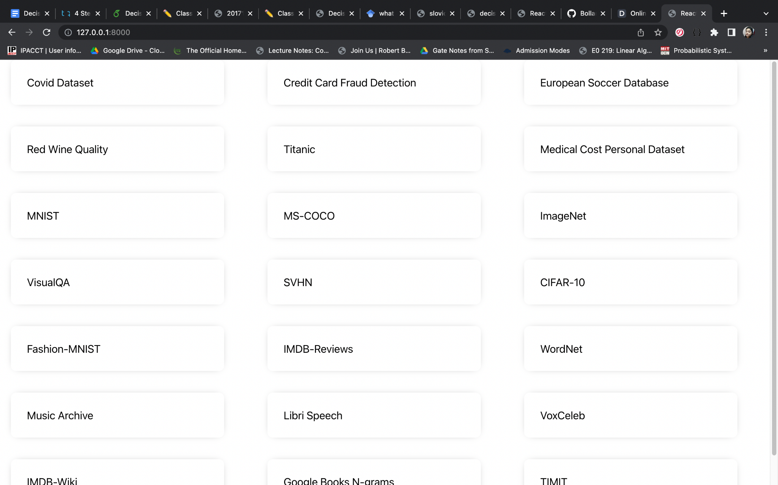
Deliverables
Display datasets

Slide 10
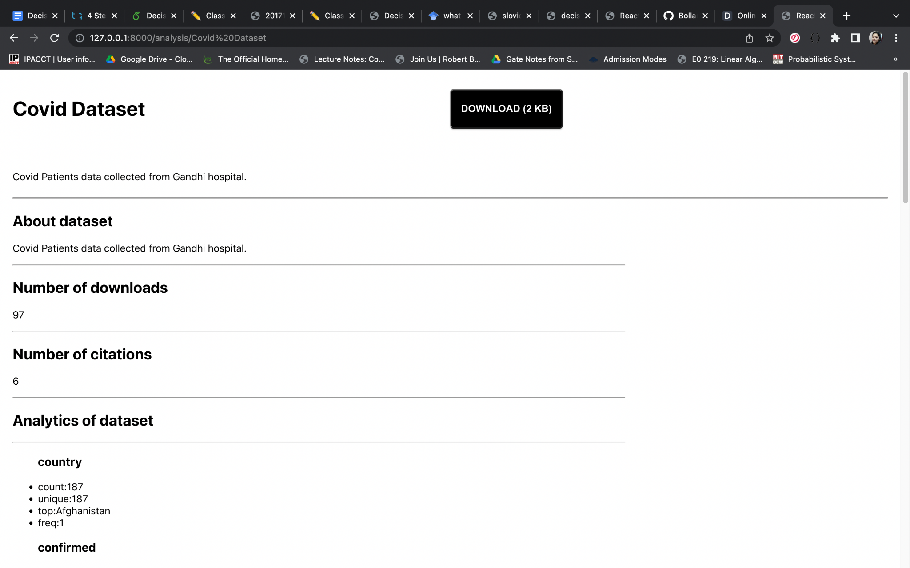
Deliverables
Display Metadata

Slide 11
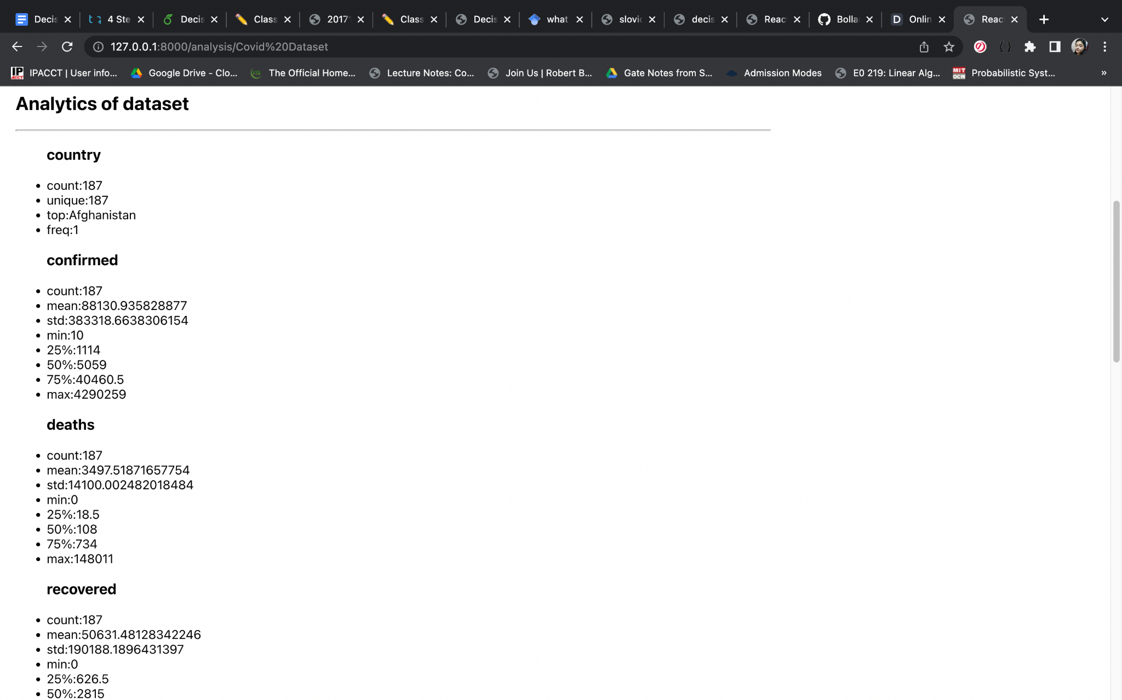
Deliverables
Display Analytics

Slide 12
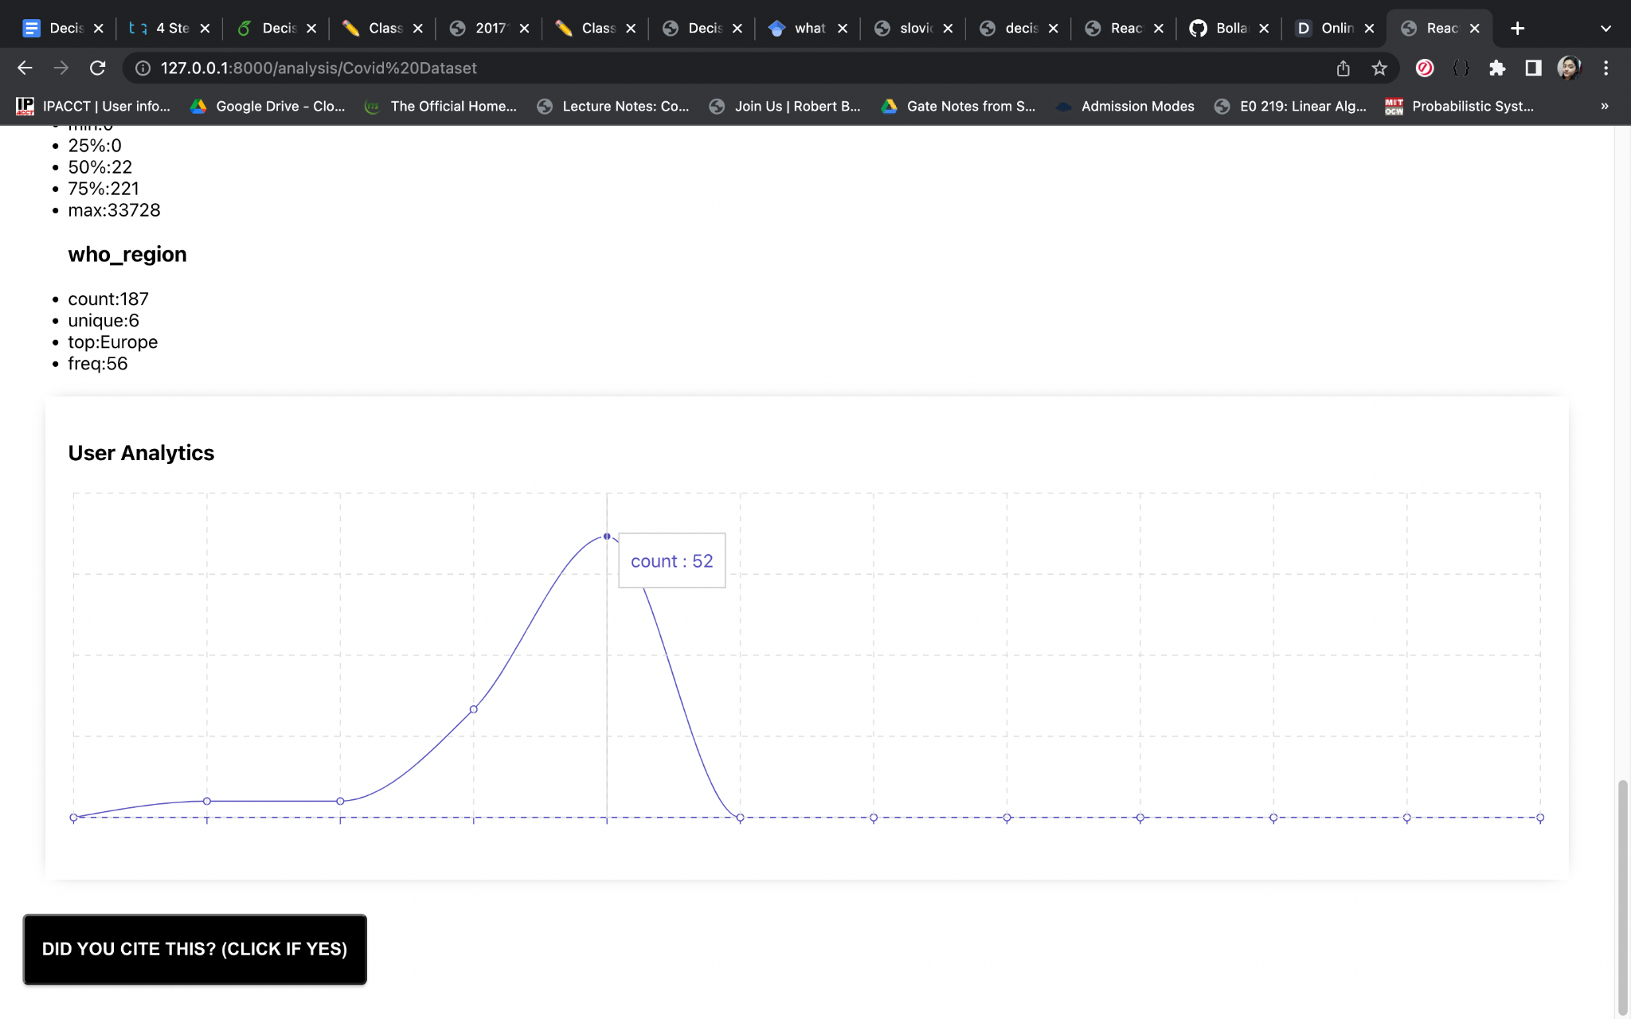
Deliverables
User input for citations

Slide 13
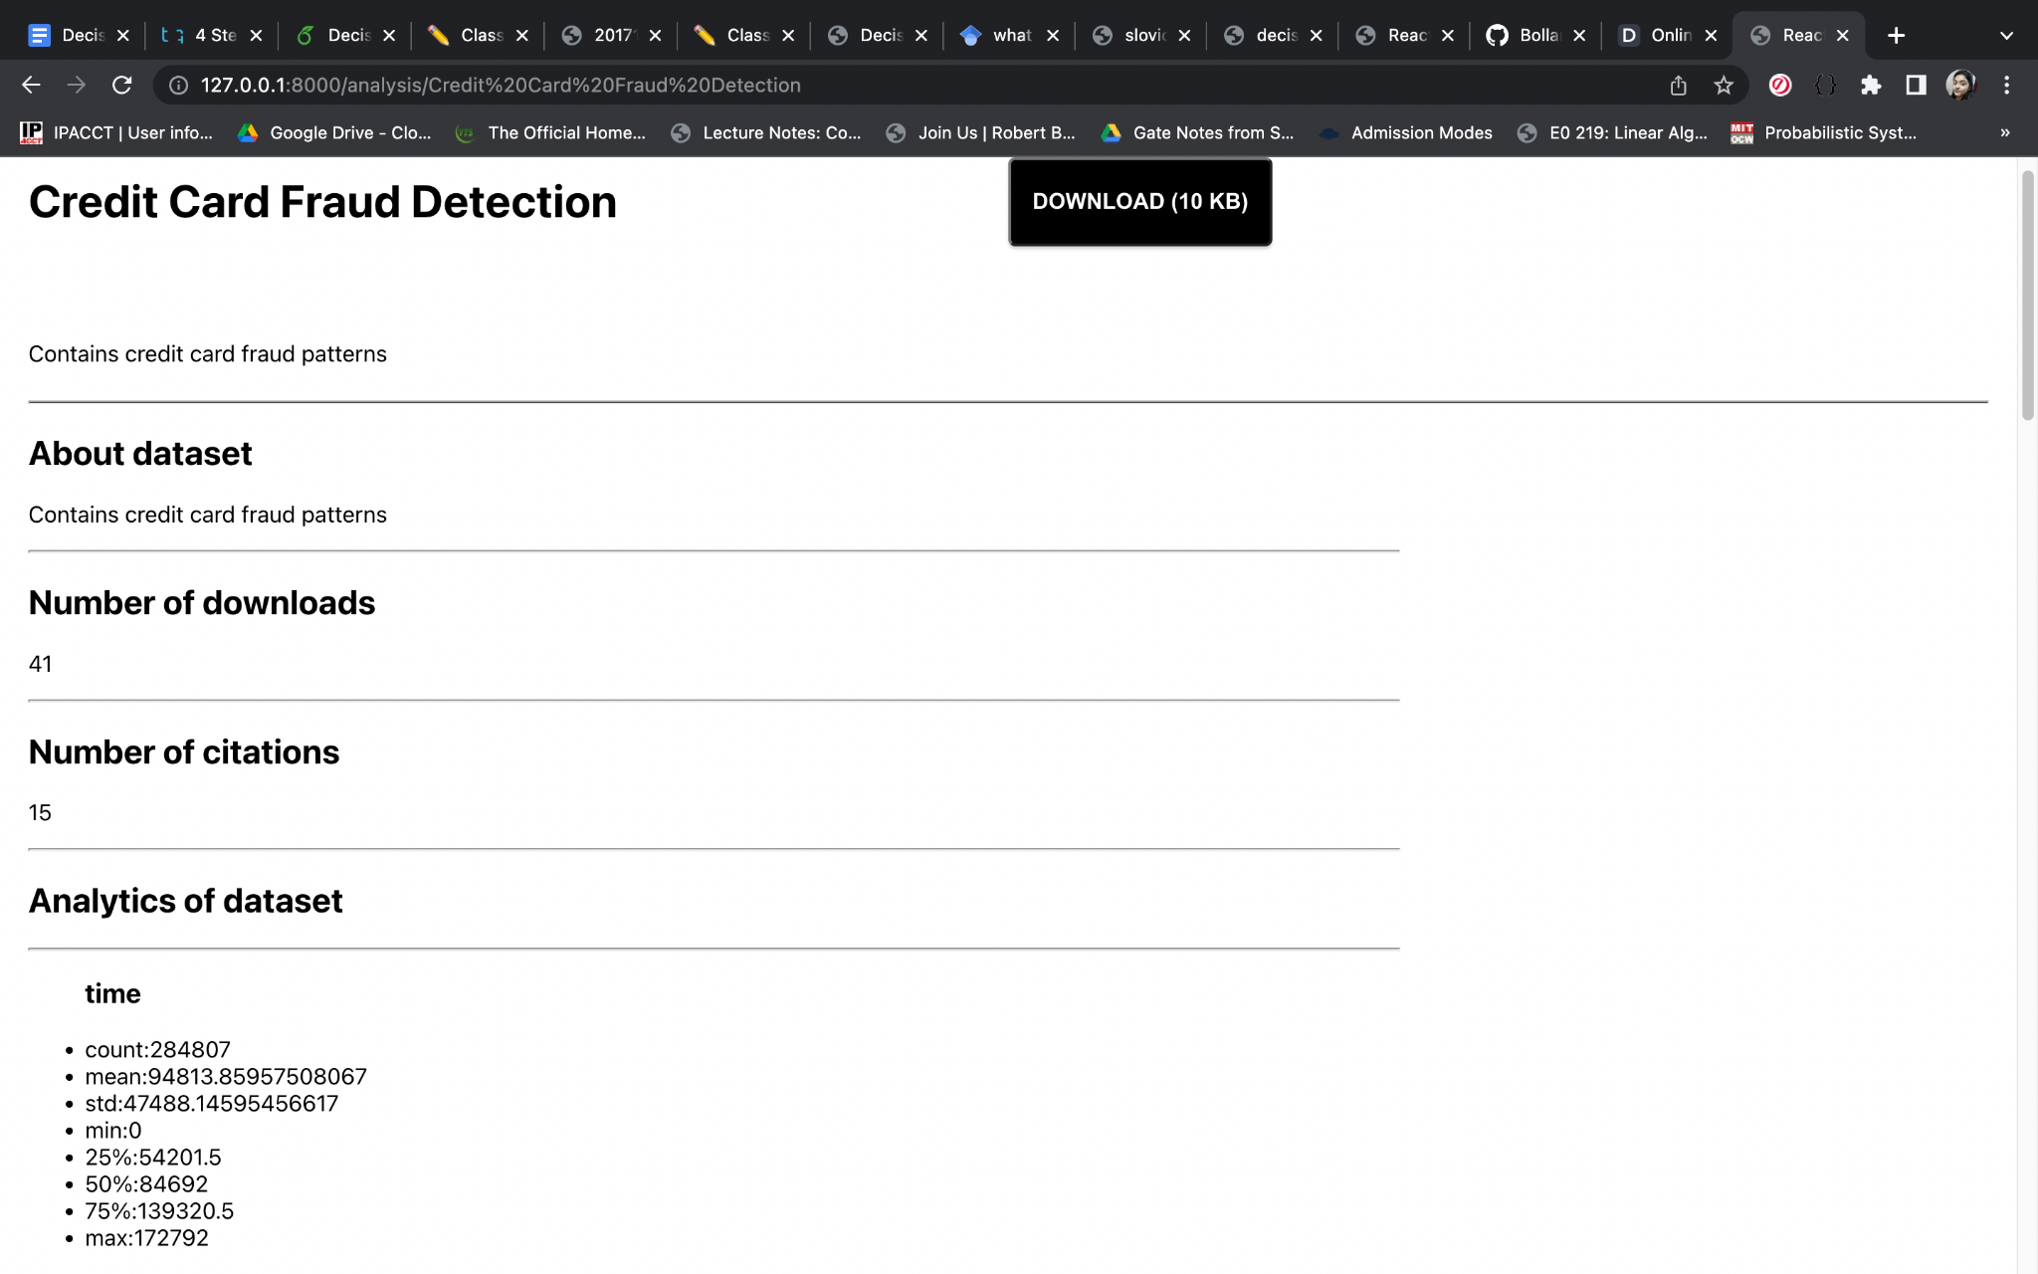
Deliverables
Tracking downloads

Slide 14
Deliverables
Backend and frontend integrated (seamless api calls of get and post from and to front end)
Dynamic persistence (Any change in frontend persisting on backend and also re-rendered in frontend)
Modular clean code with no repetition
REST framework with total separation of front end and back end (two different apps)
Front end can totally be separately statically rendered and worked upon if needed by frontend developer to work on UI
Proper documentation of readme clearly stating all installations and packages needed, how to install and execute the code
Requirements.txt consisting of all packages and dependencies required
Code documentation

Slide 15
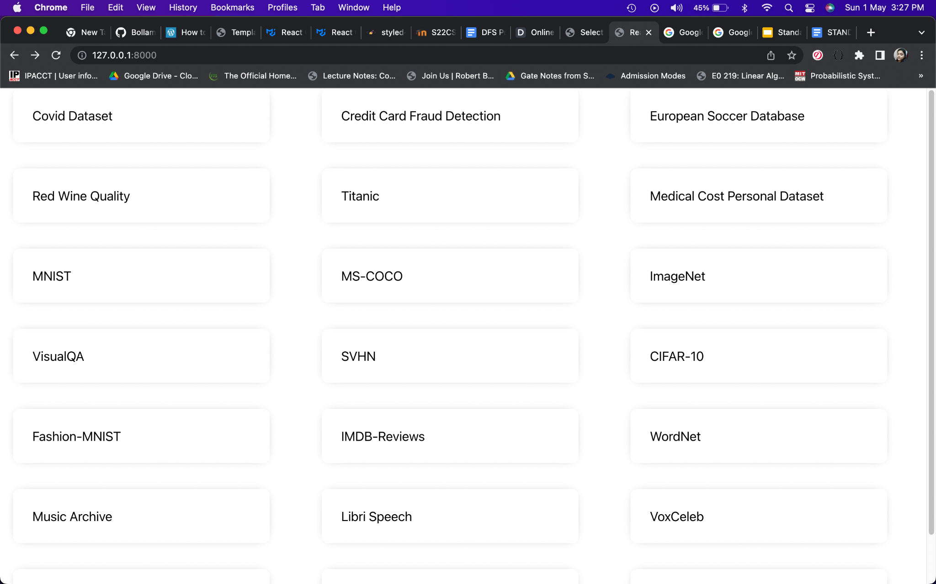
Listing Datasets

Slide 16
Displaying Dataset Metadata

Slide 17
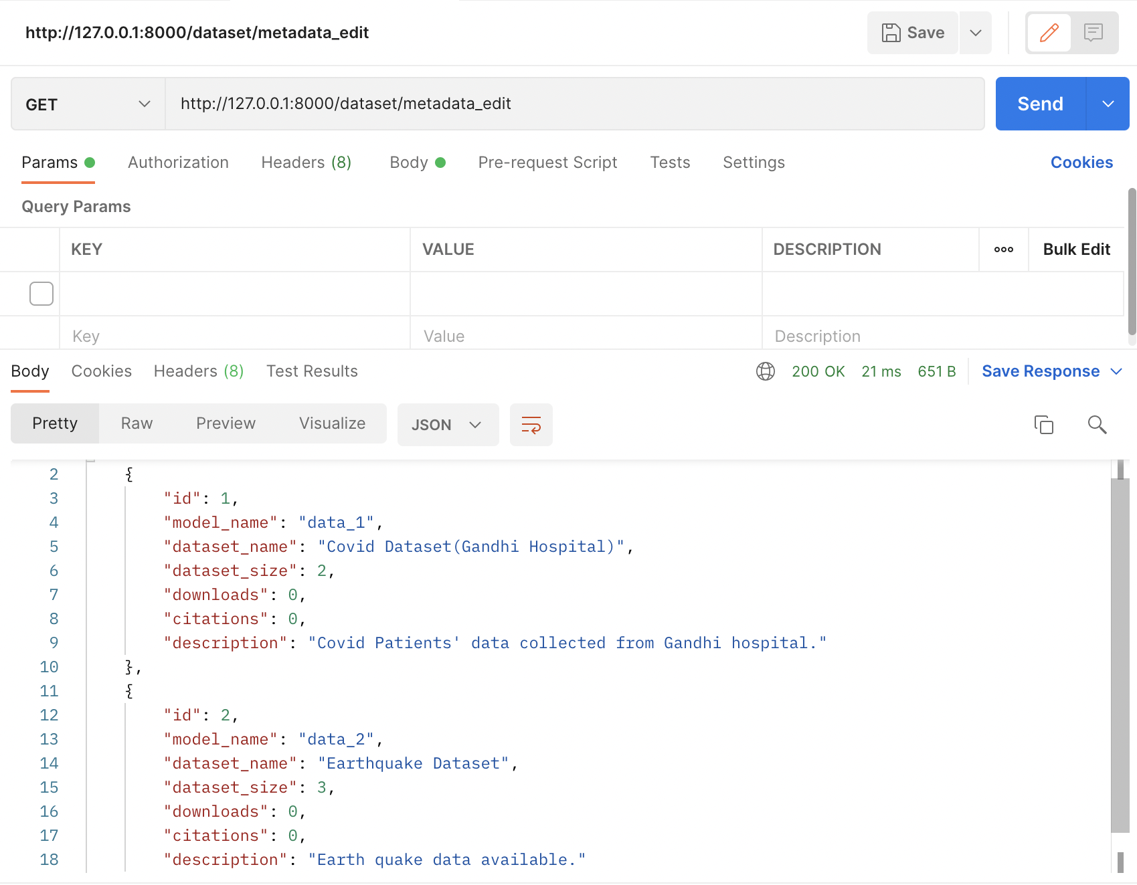
Backend GET metadata

Slide 18
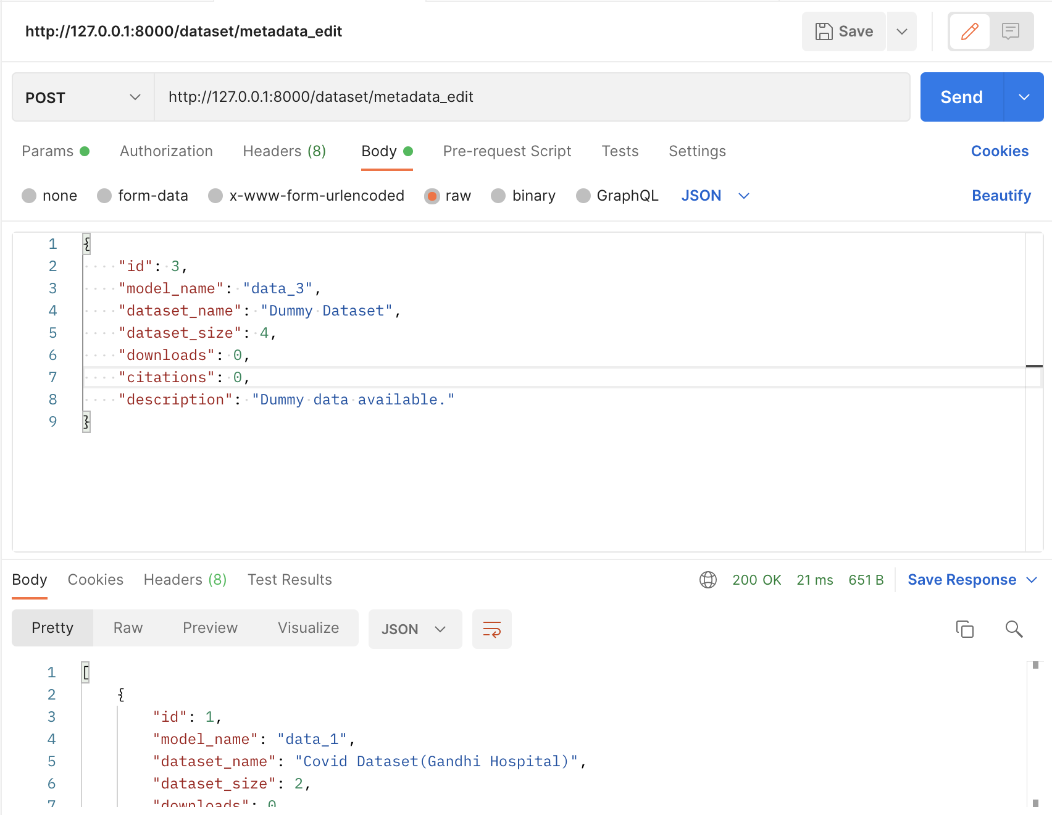
Backend POST metadata

Slide 19
Individual Contributions
Sindhu:
Created backend database- metadata model and rendered covid dataset
Linked frontend to backend to get metadata info and display in analysis page
Backend and frontend integration, download issue resolved
Backend standard analytics calculation on dataset columns
Adrija:
Created homepage with list of datasets linked to respective analysis pages
Created api calls to edit metadata table
Front-end analysis page addition of features, user analytics graphs displayed
Retrieving backend data to frontend
Likhitha:
Created download button and updating the parameters in the database using REST APIs
Getting the metadata from backend to display on analysis page
UI enhancement of dataset list
Displaying analytics data on front end

Slide 20
Questions?
Thankyou

